Slide 1
Grooming of Smarter Information Professionals
Dr. Vijayakumar K. P.
Former Head & Hon. Director, Centre for Information Literacy Studies
Dept. of Library and Information Science, University of Kerala
Thiruvananthapuram – 695 034
kpvijayakumar2@gmail.com

Slide 2
The secret of genius is to carry the spirit of the child into old age, which means never losing your enthusiasm.
-- Aldous Huxley

Slide 3
Introduction
The entire context in which libraries operate is changing dramatically.
Instead of just acquiring, processing and retrieving documents and making them available to the public, in the changing societal, cultural and technological context, libraries need to create context and meaning as added value.

Slide 4
Introduction…
In this ‘age of innovation’ radical changes across all aspects of life occur (Prahalad & Krishnan, 2008).
The fundamental shift in the position and role of the library in society brings with it a paradigm shift in the job profile of the people working in libraries and information centres.

Slide 5
Traditional job profile
Traditionally, five main tasks were part of a librarian’s job profile:
-- making information available;
-- keeping the materials collection up-to-date;
-- arranging and storing information;
-- assisting users in finding information; and
-- exchanging information with other libraries.

Slide 6
New job profile
In the new job profile, the information professional has to be:
-- an expert in using sophisticated online search engines,
-- able to make new linkages,
-- critical about the quality of information (sources), and
-- innovative in the relationships with the users in search of new meanings that fit with their needs.

Slide 7
New job profile …
In other words, in the course of two decades, the job description of a librarian has moved from information technician to knowledge worker with a focus on innovation.
Learning, creativity and knowledge sharing are crucial competences for knowledge workers in general, but even more so for librarians.
On the other hand, it is foolish “to do today's job with yesterday's tools and yesterday's concepts” (Marshall McLuhan).

Slide 8
New job profile …
With the changing times, the face of not only the corporate world but that of the services professions is also changing.
The need-of-the-hour is to have state-of-the-art professionals who are agile enough to meet the growing demands of the profession.

Slide 9
New job profile …
Till recently professional qualification was enough, but in contemporary times, besides having a superb degree, one also needs to have an extraordinary personality and the right attitude.
This has become all the more necessary with the advent of the LPG – liberalization, privatization and globalization where professionals are supposed to be groomed as world citizens.
Herein comes the need for professionals to be smarter.

Slide 10
SMART
The word ‘smart’ is used in English language as an adjective, as a verb and also as a noun.
As per the Oxford Living Dictionaries:
As an adjective, it has the following meanings:
-- (of a person) clean, tidy, and well dressed.
-- (of clothes) attractively neat and stylish.
-- (of an object) bright and fresh in appearance.
-- (of a place) fashionable and upmarket.
(informal) having or showing a quick-witted intelligence.

Slide 11
SMART…
As per the Dictionaries.com, smart means:
-- quick or prompt in action.
-- having or showing quick intelligence or ready mental capability.
-- shrewd or sharp, as a person in dealing with others.
-- clever, witty, or readily effective, as a speaker, speech, etc.
-- dashingly or impressively neat or trim in appearance, dress, etc.
-- socially elegant; sophisticated or fashionable.
-- saucy; pert,

Slide 12
Expansion of SMART (in the context of Goal Setting)
S – SPECIFIC. It can be stretching, systematic, synergistic, significant, and shifting.
M – MEASUREABLE. It can also be measurable, meaningful, memorable, motivating and even, magical.
A – ATTAINABLE. It also stands for accountability, acumen, and agreed-upon.
R – RELEVANT. It also stands for realistic, reasonable, result- oriented, rewarding, responsible, reliable, and remarkable.
T -- TIME-BASED. It represents timely, tangible, and thoughtful.

Slide 13
Smart Professional
A smart person can do four things:
see useful information that other people can’t see or don’t notice;
draw accurate, useful conclusions from that information;
3. design a useful goal that takes advantage of that information, and
create an efficient and effective plan of action to attain that goal.

Slide 14
Smart Professional
More simply, really smart people see the dots other people don’t see.
They connect those dots into an accurate picture.
They derive a useful goal from that picture, and
They plan an efficient, effective way to reach that goal.

Slide 15
Smart libraries
The concept of smart libraries involves developing, transforming and repositioning libraries to innovate and strive for improvement.
Smart libraries have transformative impact on users to operate according to high professional standards, ethical principles and values.
These libraries, exemplify knowledge-based organizations, use research and data to build understanding, make decisions and decide the future, focus on laws, principles, ambiguity, uncertainty to create positive outcomes and constructive relationships.

Slide 16
Smart libraries…
Smart libraries offer smart services.
Smart services are services that are informative, interactive, innovative, improving and international in scope.
Smart services enrich the lives of the members of a smart community.
Smart services provide networked communities with interactive software and multimedia content through secure community access facilities.

Slide 17
Smart challengers
Smart formats: e-books, kindles, vooks and so on.
Implementing Web 2.0 technologies
Portal development
Social networking:
-- Generation Y behavior
-- Information from peer networks
-- Reliability of information
New models of publication:
-- Fee or free
-- Google books settlement

Slide 18
Smart challengers…
Delivering library services through mobile services
New roles for professional associations
-- Widening their interest
-- Widening their spheres of influence
-- Preparing their members for the new world of information and knowledge management
-- Lobbying, explaining and lobbying with decision makers

Slide 19
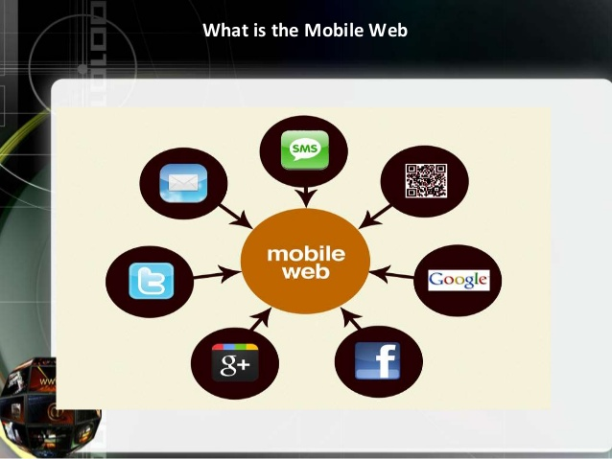

Slide 20
Smart libraries by Samsung
A new vision of the libraries was put forward by Samsung.
Their philosophy is that although there’s nothing wrong with silently studying by oneself at a local library, studying with a group can ultimately prove more productive.
This allows one’s ideas to be constructively critiqued and their progress to be appraised.
While an innovative thought or groundbreaking idea may certainly hatch in the mind of one person, honing such an idea with others’ informed input can go a long way toward improving and realizing it.

Slide 21
Smart libraries…
The first S. hub, installed in the Ho Chi Minh City General Science Library, opened its doors in October 2016.
S. hub Hanoi, meanwhile, which established a collaborative space for students and young professionals to gather in the Vietnamese capital, launched it on 24 November 2016.

Slide 22
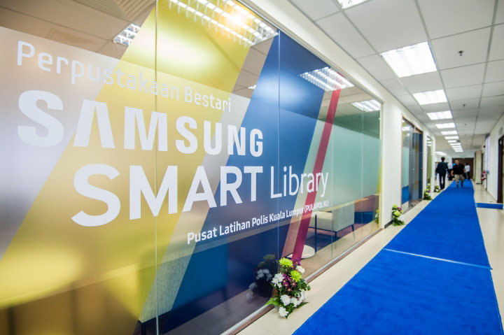

Slide 23
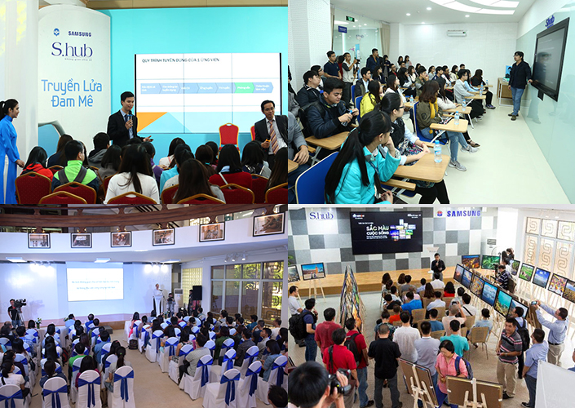

Slide 24
Smart libraries by Samsung…
The goal of the initiative is not only to update the facilities with modern tech like touchscreen monitors and personal tablets, but to also create spaces that can serve as scholarly hubs where people, especially students, may gather and nurture one another’s academic inclinations.
Samsung launched its Sixth SMART Library for the Pusat Latihan Polis (PULAPOL -- Malaysian Police Training Centre ) Kuala Lumpur.
With the launch of Samsung SMART Library in PULAPOL KL, more users and young police officers can now have access to plenty of digital reading resources to assist their mandatory trainings and a wide range of information that will help enrich their minds.
This initiative is also in line with Samsung’s aim to spread positive change for everyone, helping them live a better life full of possibilities.

Slide 25
Professional and Personal Competencies
Competency is very often thought of as the possession of necessary skills and knowledge but, more than that, it involves understanding of one’s role and the motivation to fulfil it.
Special Libraries Association (SLA) has classified the competencies of LIS professionals under two categories
– professional, and
-- personal.

Slide 26
Personal competencies
Personal competencies, on the other hand, represent a set of skills, attitudes and values that enable library professionals to work efficiently.
They include:
-- good communication skills,
-- an inclination for personal development,
-- value addition to whatever they do etc.

Slide 27
Personal competencies…
It is the cluster of:
-- personality traits
-- social graces
-- communication skills
-- language skills
-- etiquette
-- friendliness
-- listening skills
-- negotiation skills and optimism

Slide 28
Personal competencies…
They are behavioural skills and therefore, are highly personal.
These skills are related to the head, heart, hands and health, i. e. highly personal.
These behavioural skills reflect our personality and naturally helps in personality development.
They are also termed as life skills.

Slide 29
Personal competencies…
Life skills that make the professionals smart are:
Communication skills
Aptitude for leadership
Interpersonal skills

Slide 30
Desiderata in the new age: a few examples
Information curation
Big data
Virtual reality
Artificial intelligence
Block chain technology
Internet of Things
Expertise in quality indicators
Altmetrics
Digital preservation
Collaboration and facilitation

Slide 31
Information curation
As content creation becomes available to all, information curation becomes a more critical skill.
“Curation is the act of individuals chartered with the responsibility to find, contextualize, and organize information, providing a reliable context and architecture for the content they discover and organize.”

Slide 32
Big data
Big data is a term that describes the large volume of data – both structured and unstructured – that inundates the world on a day-to-day basis.
Big data can be analyzed for insights that lead to better decisions and strategic business moves.
While the term “big data” is relatively new, the act of gathering and storing large amounts of information for eventual analysis is ages old.
The concept gained momentum in the early 2000s when industry analyst Doug Laney articulated the now-mainstream definition of big data as the three Vs – Volume, Velocity and Variety.

Slide 33
Big data…
Big data is driving the need for research and analysis.
Every single person with a smartphone or other internet-connected device is adding to the river of information.
All these people and devices generating diverse amounts of information necessitate people to categorize, discover and help make sense of the information.
Who possesses those inherent capabilities more than a librarian?

Slide 34
Virtual reality (VR)
Allowing people to immerse themselves in a new universe is one of the main reasons why people enjoy reading books and accessing the libraries’ collections.
It is now possible to offer a new attractive format for the same experience using virtual reality.
VR offers the users the chance to play, learn and explore other places just by sitting in the comfort of their local library.
Virtual reality can also be used to bring the library closer to the users by creating virtual tours of the library or even virtual workshops and training.

Slide 35
Artificial intelligence
Artificial intelligence is no longer a futuristic perspective as it is gaining more and more traction in our everyday activities.
With many AI applications focused on delivering information to the user, it may appear that AI is a challenge to libraries.
But adding an intelligent side to all applications at the library is a real opportunity to understand the patterns in user behavior and adapt to their needs.

Slide 36
Block chain technology
Block chain technology is one of the most discussed technologies nowadays.
Block chain technology represents a decentralized database that keeps records of pseudonymized digital transactions that are visible to anyone within the network.
Therefore, it is a new way to collect and store data.
But it could be used to build an enhanced metadata system for libraries, to keep track of digital-first sale rights and ownership, to connect networks of libraries and universities, or even to support community-based borrowing and skill sharing programs.

Slide 37
Internet of Things
As the RFID technology, IOT refers to the possibility of connecting everyday devices and transferring data between them.
But only in the case of IOT, the data is transferred over the Internet. As a recent article on American Library Association website highlights, there are many “opportunities for library applications, from tracking room usage and program attendance to monitoring humidity levels for special collections and more”. (ALA, n.d.)
Therefore, the library can offer a better user experience by enriching its services and collections.
ALA (n. d.) gives the example of Hillsboro Public Library in Oregon who has introduced the Book-O-Mat, a self-service kiosk, which is monitored from the main library to track usage and identify usage trends and make recommendations.

Slide 38
Expertise in informetric indicators
Citation count
Informetric indicators:
-- Impact factor
-- Scopus citescore
-- Eigenfactor
-- h-index, g-index
-- i10 index
-- Collaboration pattern

Slide 39
Altmetrics
Altmetrics, short for alternative metrics, is a quickly developing methodology for measuring the impact of scholarly works and research published on the web.
Proponents of altmetrics note that article citations and journal impact factors do not accurately measure the impact of web-based articles or the ensuing scholarly communication among scientists, scholars, and researchers.
Altmetrics, then, supplement the traditional means of measuring scholarly impact and the slower peer-review process.

Slide 40
Digital Preservation
Digital Preservation, at first glance, looks like an oxymoron.
Most people believe that if it is in digital format, it’s already preserved.
But it is a fact that digital formatting is only a preliminary step on the road to digital preservation.
The ability to foster and steward those digital orphans into long, useful lives is a valuable and necessary skill.

Slide 41
Mobile Environment
As more information is being stored in the cloud, and searched for and consumed using mobile devices, librarians must be familiar with mobile environment.
Librarians skilled in the use of mobile devices like tablets and smartphones can help ensure that their strengths are being considered and built-in to the library’s information systems and portals.
Librarians should understand the pros and cons of cloud computing, to serve as advisers and consultants to those decisions as they apply to information curation and digital preservation.

Slide 42
Collaboration and Facilitation
Librarians can position themselves as valuable resources by collaborating more actively with management and leadership within the organizations they work.
Librarians who adopt these skills will revitalize their careers, increase the visibility and viability of their profession, and become valued information professionals.

Slide 43
Collaboration, Coaching and Facilitation…
A common memory or understanding we have about libraries – whether public, academic or private – was being ssshhh’d by a librarian!
Talking, noisily shuffling papers or otherwise being too loud are verboten (forbidden) in most libraries.
Only churches offer more silent space.

Slide 44
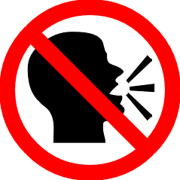



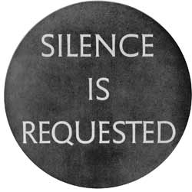


Slide 45
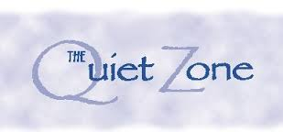
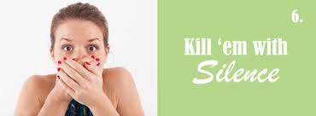
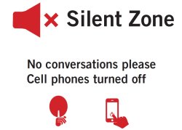

Slide 46
Collaboration, Coaching and Facilitation…
Those library walls are starting to crumble.
The library of the future may feature less space dedicated to quiet study and more space devoted to presentations, discussion and collaboration.
Increasingly, libraries are becoming a place for meeting, sharing and collaboration.

Slide 47
Thank You

